Slide 1

Testing Machine Learning Code Using Polyhedral Region
Md Sohel Ahmed, Fuyuki Ishikawa, Mahito Sugiyama
Department of Principle and Informatics
National Institute of Informatics
Tokyo, Japan

Slide 2
Outline
What is Post Selection Inferences(PSI)?
How Polyhedral region (Extract from Lasso based theory)?
Testing whether a bug exist or not in machine learning code.
Results and Summary

Slide 3
Post-Selection Inference(PSI)
Selective inference or PSI framework is becoming popular recently after the landmark studies by Lee et al (2016).
In case of LASSO selection event can consist of set of linear inequalities.
This seminal result is known as a Polyhedral lemma and is quite effective for the test statistic as a Selective inference.
Selective Inference framework has been studied for several problems where the assumptions of Polyhedral lemma are satisfied (Lee and Taylor, 2014).

Slide 4

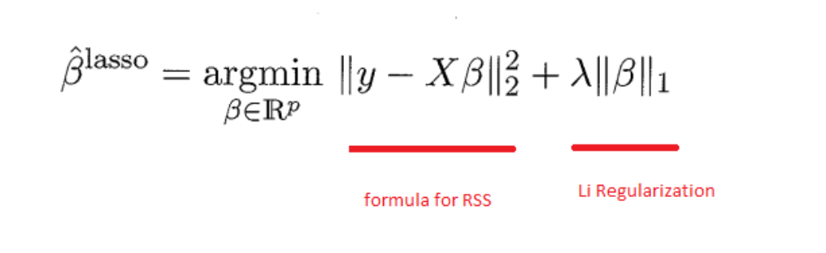


Lasso Shrinkage Works
Finding a set of statistically significant features is very important, and (LASSO)
is a popular method [Tibshirani, 1996].
Lasso is a penalized method and Lasso performs L1 regularization.
Regularization is a process of introducing in order to prevent overfitting.
L1 regularization adds a factor of sum of absolute value of coefficients.
To fit the best model lasso try to minimize the residual sum of square with penalty L1 regularization and Lasso provides an estimate of
that solves (Tibshirani, 1996).
where
are
and
norms, respectively, given as
and

Slide 5



Lasso Optimization Problem
Lasso produces sparse solution and defined predicts with non-zero coefficients (Lee at al.2015)
Suppose a set of variables
with
with sign vector
The output of Lasso is a variable set

Slide 6


Our Approach for Machine Learning Code Testing
Selecting relevant variables (features) from a supervised multivariate dataset (X,y)
is a design matrix with 𝑛 observations and 𝑝 variables and
is a response vector.
Lasso finds a set of variables 𝑀⊆ {1, . . . , 𝑝} that is informative to predict y form X.
Hence, from the ML system view point (X, y) is input and 𝑀 is output.
The polyhedral region for a possible output is obtained in the form of Ay′ ≤ b for some . And , where A and b are computed from X, y and 𝑀.

Slide 7

Our Testing Approach
The polyhedron Ay′≤b is satisfied for any response vector
Selected variables 𝑀′ from (X,y′) should be exactly the same with 𝑀, if Ay′≤b
Lasso code can be tested using this property.
Most of mutants can be successfully detected by our approach in mutation testing.

Slide 8
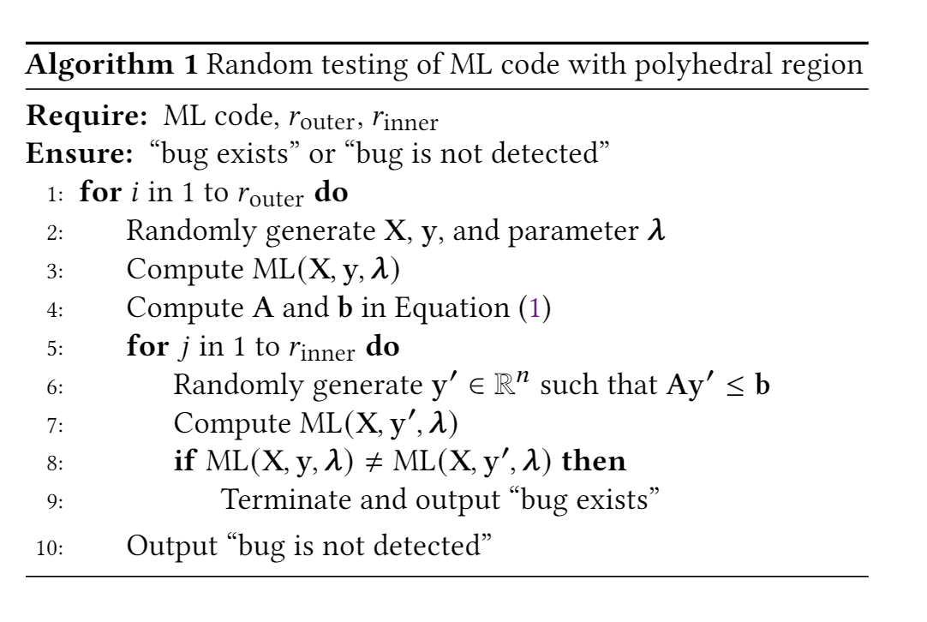
Algorithm

Slide 9
Polyhedral Condition Exists Bugs or not
The seminal paper by (Lee et al. 2016) provides the polyhedral lemma, which gives us a probability distribution over the space of the polyhedron.
It can remove a bias in statistical hypothesis testing.
We obtain the polyhedral condition as
For, any y′ satisfying the condition Ay′≤b,
ML(X,y,𝝀) = ML(X,y′,𝝀) ( bugs is not detected )
ML(X,y,𝝀) ≠ ML(X,y′,𝝀) (bugs is detected)
Randomly created pair (X,y) and apply the ML system to get result ML(X,y, 𝝀) from Ay′≤b.

Slide 10
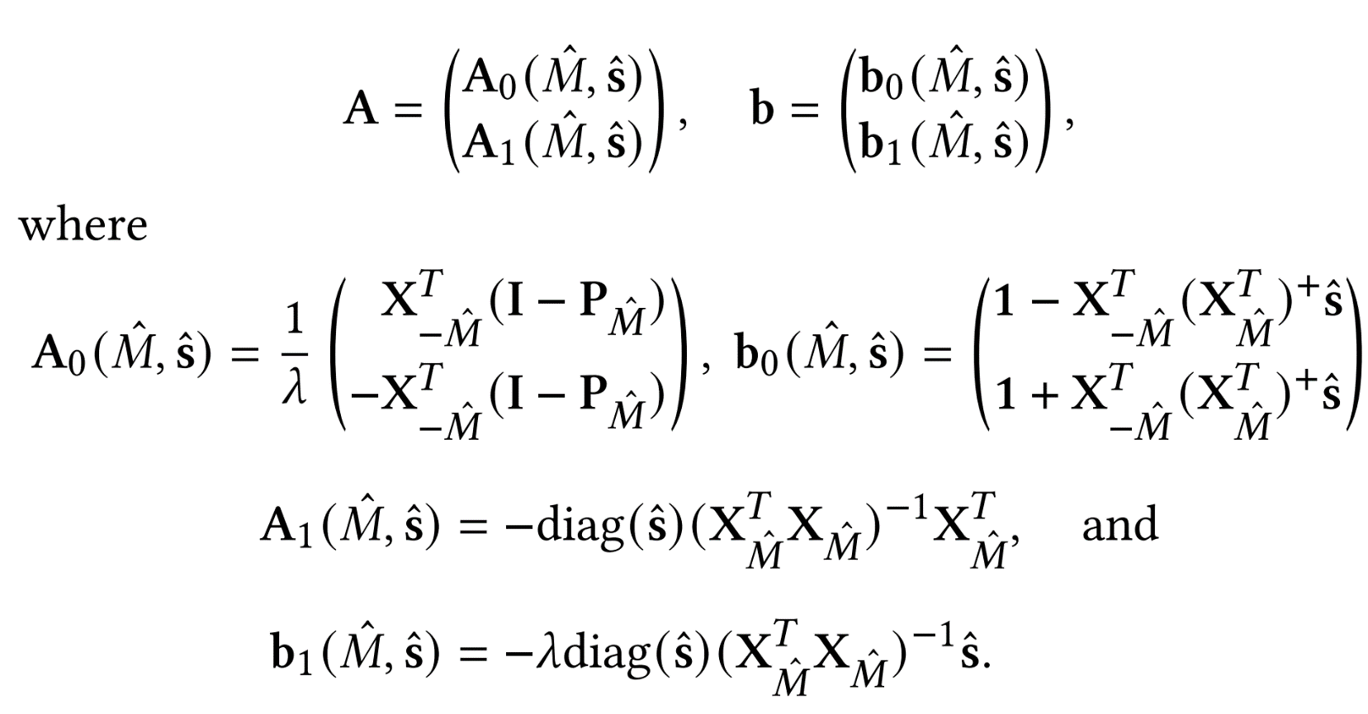






Computation of A and b
We apply the lasso with parameter λ to data (X, y), yielding active variables M. For active variables A₁ and inactive variables A₀ compute the following way (Lee et al. 2013)
Let
be the pesedo inverse of the square matrix
and
be the submatrix of X with respect to columns of M
be the submatrix of X with respect to columns of [p]\M
be the projection onto the columns of

Slide 11
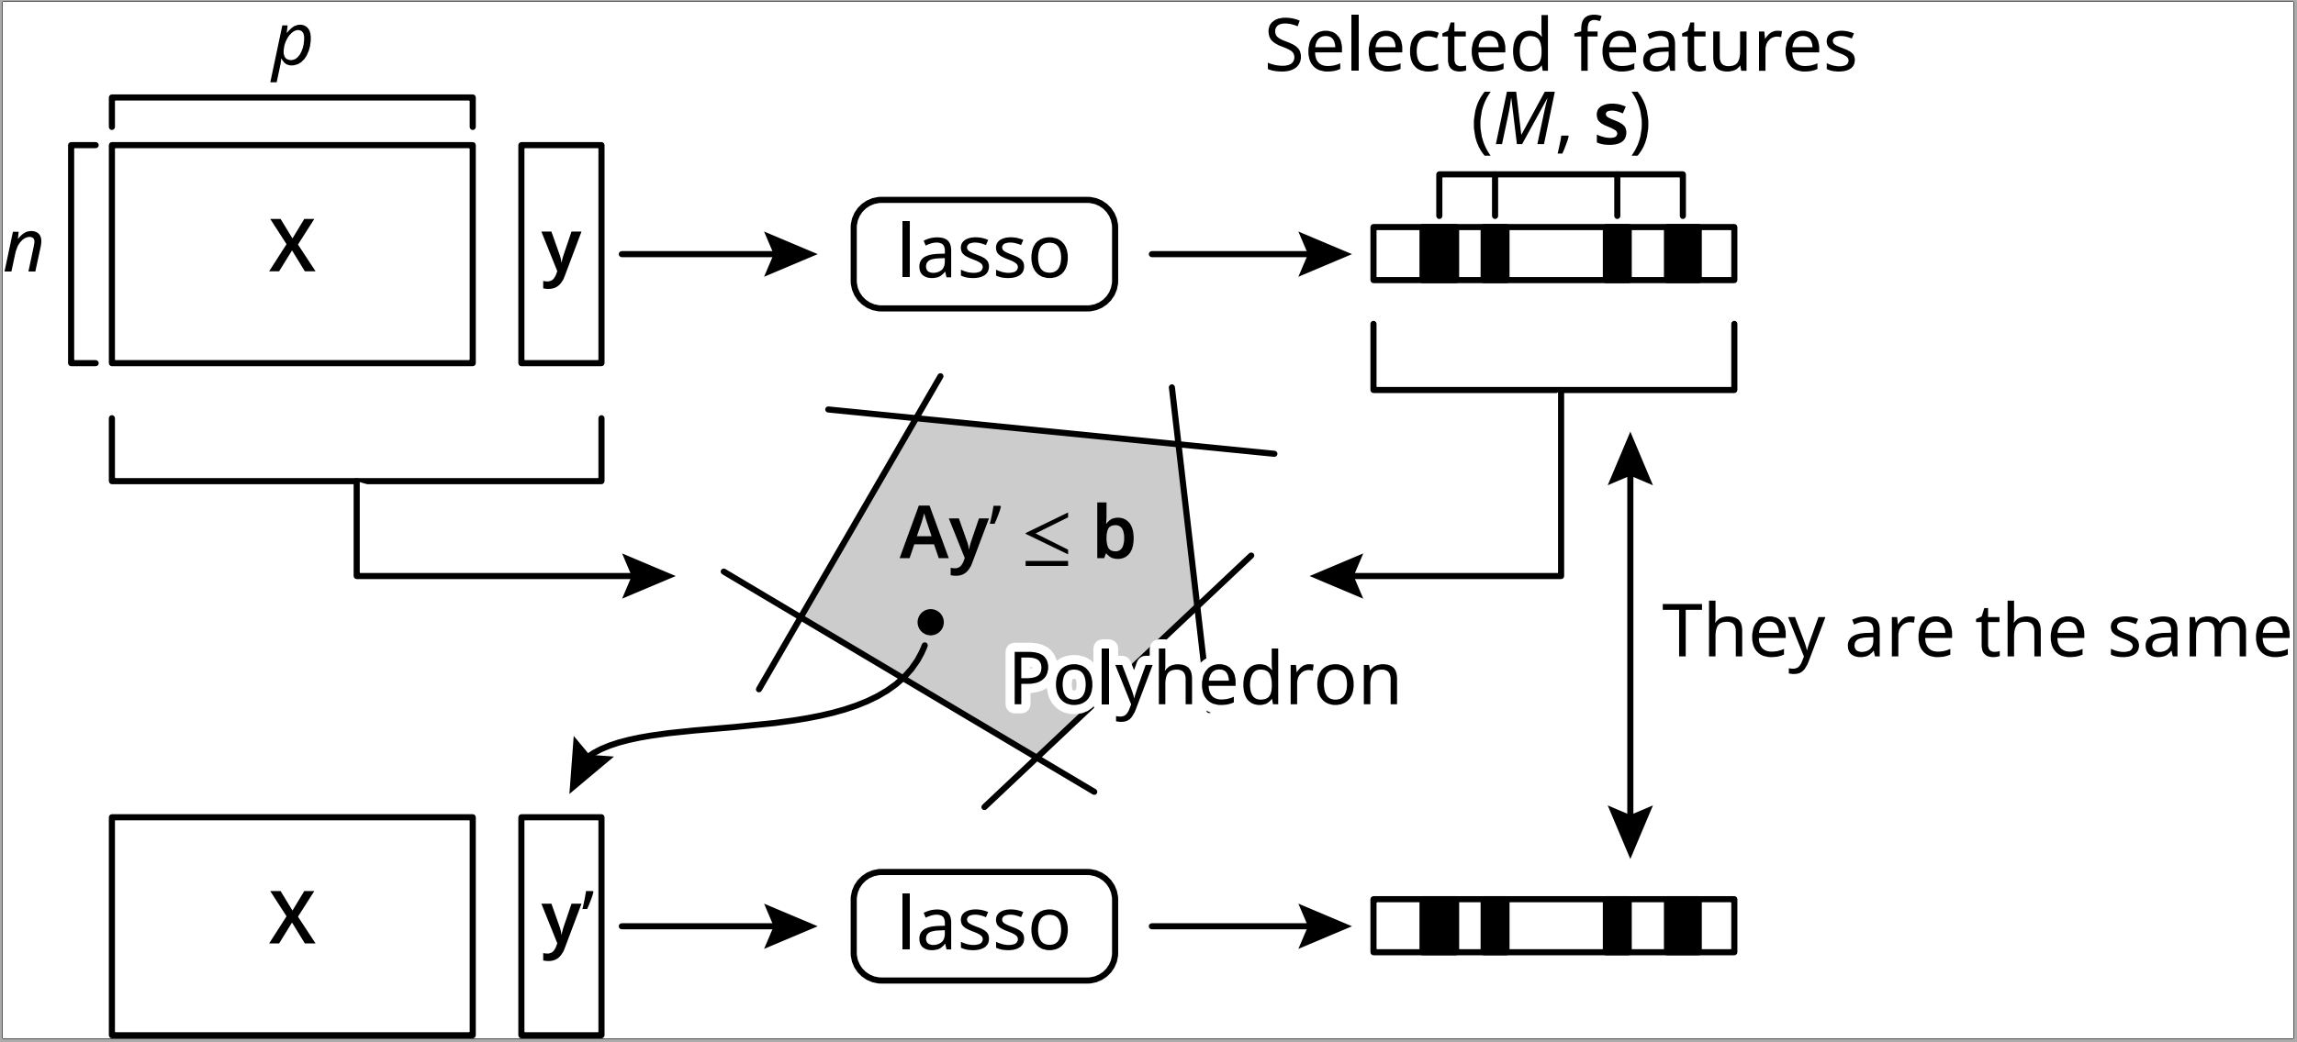
Polyhedral region how it works in Lasso

Slide 12


Experimental settings
We set n = 50, p= 10, λ =0.8,
We repeat randomly generating
and
We repeat 1000 times for generating
ML(X,y,𝝀) ≠ ML(X,y′,𝝀),
If at least one
satisfies the condition
we detect the bugs and our method can successfully detect the mutants.
ML(X,y,𝝀) = ML(X,y′,𝝀)
If the condition
is satisfied for any our method cannot detect the bugs

Slide 13
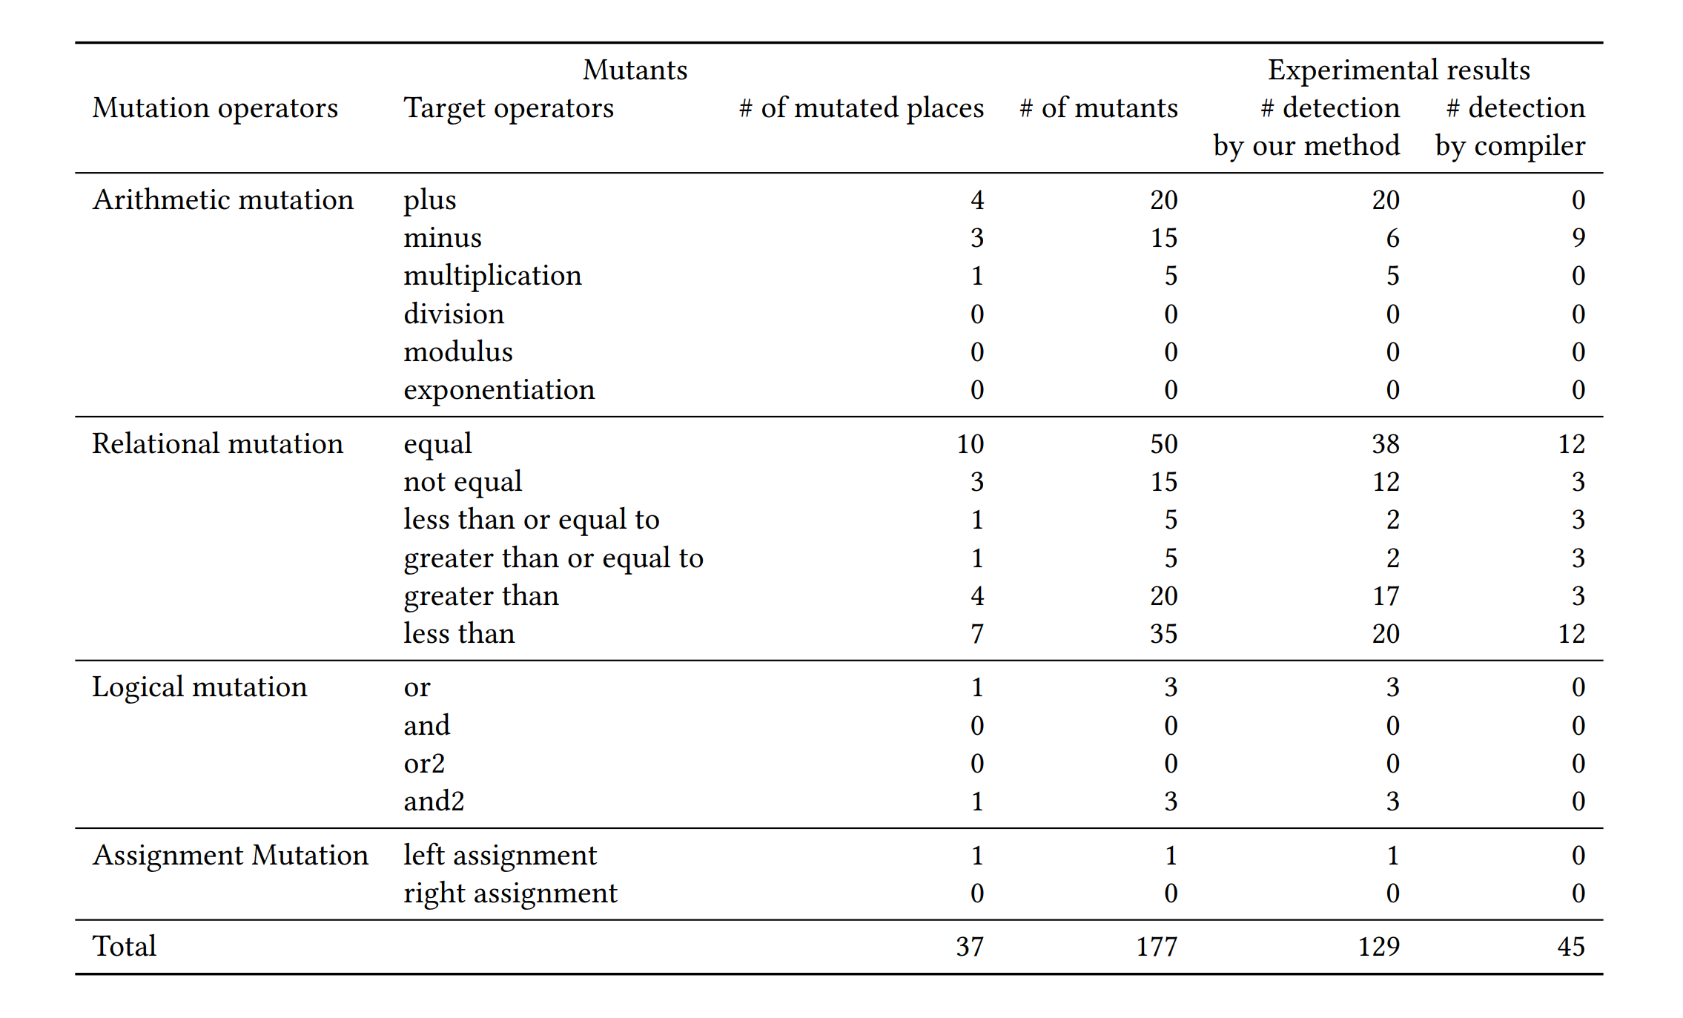
Results
Table: Generated Mutants from Lasso code and Experimental results

Slide 14
Results Summary
We tested 177 mutants of lasso R implementation and examined whether or not we can
detect these mutants by our approach using polyhedral lemma.
Results are as follows:
1. # detected mutants: 129; Our method successfully detected 98% mutants (129/132)
2. # detected mutants based on complier error, but not our proposal method: 45
3. # Non detected mutants: 3

Slide 15
Conclusion and Summary
Our testing method successfully detects 98 % of mutants of the lasso code efficiently.
At present, it is hard by any other testing methods to reach such percentage to detect mutants.
Polyhedral characterization applies to not only the lasso but a broad range of ML algorithms.
Our method has a wide applicability for the ML code testing.
Our method can be a fundamental of ML testing techniques, and will lead to further development of testing methods for ML implementations.

